Slide 1
CS 4350: Fundamentals of Software Engineering Lesson 4.1: Concurrent Programming Models
Jonathan Bell, Adeel Bhutta, Ferdinand Vesely, Mitch Wand
Khoury College of Computer Sciences
© 2022 Released under the CC BY-SA license

Slide 2
Learning Goals for this Lesson
At the end of this lesson, you should be able to:
Explain why almost all programs need to support concurrent actions
Understand how to write code that uses asynchronous results using async/await
Notes:
<read slide>

Slide 3
Masking Latency with Concurrency
Consider: a 1Ghz CPU executes an instruction every 1 ns
CPU 1
Main Memory
150,000ns (just to read 4KB)
SSD
thread0()
CPU 1 Cache
7ns
100ns
10,000,000ns (just to seek!)
Magnetic HD
~100,000,000ns
Remote Computer (Internet in between)
3
Notes:
First principles: why do we need concurrency?
Mostly I/O. We are spoiled today with huge amounts of RAM, but there are still occasions when you need to read or write something to/from disk, or to/from network.
This diagram shows roughly the overhead of different kinds of I/O, in nanoseconds. Cutting-edge hardware architectures and OS designs aim to reduce these delays, but the rough order of magnitudes still stand.
If we are “computing” things (running instructions on the CPU), on a 1Ghz CPU, that’s nice and round, so you get 1 instruction executed per nano-second. You could run 150k instructions in time to read 4KB from SSD, 10m instructions in time to get the read head on your spinning magnetic HD into place to read something, or 100m instructions in time to receive a packet over internet.
So, it is desirable to be able to keep doing things while we are waiting for I/O, and not stop the world. Another way to put this, is that we would like to mask this latency to do such slow operations with concurrency: do something else while these I/O operations are happening.

Slide 4
Why Concurrency?
Maintain an interactive application while…
Processing data
Communicating with remote hosts
Timers that countdown while our app is running
Waiting for users to provide input
Anytime that an app is doing more than one thing at a time, it is asynchronous
Notes:
Broadly, we want to maintain an interactive application while doing “stuff”, read slide for description of that stuff. If you are waiting for user input, it could take a long time if the user went for a coffee break

Slide 5
Concurrency through Threads
Typical Java Example
Multi-Threading allows us to do more than one thing at a time
Physically, through multiple cores and/or OS scheduler
Example: Process data while interacting with user
Processes data, generates results
Interacts with user
Draws Swing interface
on screen, updates
screen
Share data
Signal each other
main
worker
thread 0
thread 1
Notes:
In many programming languages, like Java or C, you can have asynchronous computation with threads.
<Read slide, click to show the thread0 (build 1), thread1 (build 2), and sharing data (build 3)>
You might be familiar with this programming model. As it turns out, the “share data signal each other” part is extremely hard to get right, and almost impossible to prove correct
This is not how we get asynchronous computation in JS or TS

Slide 6

Concurrency through Asynchronous Programming
Everything you write will run in a single thread* (event loop)
Since you are not sharing data between threads, races don’t happen as easily
Inside of the JS engine: perhaps more threads
Event loop processes events, and calls your listeners (“event handlers”)
event queue
All JavaScript code runs in one OS thread
event loop
Thread 1
Thread 2
NodeJS
Multi-Threaded App
Notes:
Instead of providing concurrency through multiple threads (like we saw in the last slide, and as on the right), NodeJS has a single thread. All of the code that you every write will run in that single thread.
This means that we don’t have to worry about data races in the traditional sense, but we’ll see that there can still be situations where there are races between listeners.
JS provides some primitives that call out to the operating system to do what is called “non-blocking I/O”, or “asynchronous IO”. It is through this asynchronous IO that we can achieve concurrency in JS.
For example, such a primitive might instruct disk head 12 to move to track 34, and create a listener that waits for the event "disk head 12 has reached track 34" and then continues with the I/O task.
In the meantime, the system can continue with your code by running another listener in the event queue.

Slide 7
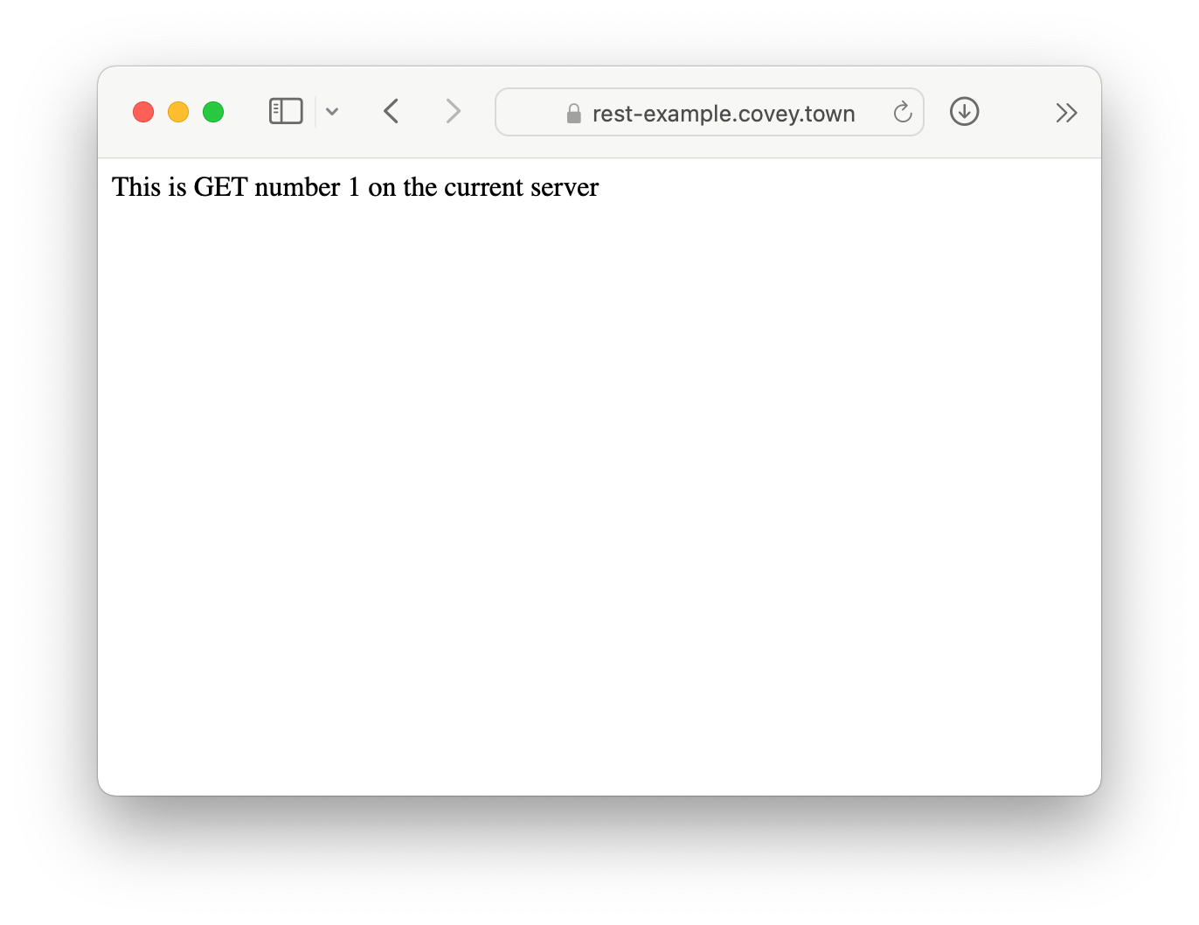
Running Asynchronous Example: HTTP Request
let nGets = 0; app.get('/', (req, res) => { nGets++; res.status(200).send(`This is GET number ${nGets} on the current server`); });
Notes:
We will take a look at how exactly asynchronous programming in JS works using the running example of making an request to a server.
Here we see the code in the server. (Explain code, key objective is to understand that it just sends back some text, and it will keep track of the order of requests (always returns GET number 1, 2, 3, …)
Our goal is to write some code for NodeJS that will send a request to the server and display the result on the console just like the browser shows here .

Slide 8
A Promise is a Representation of a Listener
The “Promise” lets us register a listener for something that will come in the future
To call a function that returns a Promise, you must ‘await’ it, from inside of an ‘async’ function
async function makeOneGetRequest(){ console.log('Making Request');
const response = await axios.get('https://rest-example.covey.town'); console.log('Heard back from server'); console.log(response.data); } makeOneGetRequest();
Output:
Making Request
Heard back from server
This is GET number 1 on the current server
Notes:
The easiest way to have asynchronous actions in JS is to use libraries that return something called a Promise.
A Promise is a representation of a listener, and lets us request some asynchronous action to happen (in the background), and then come back to this point and keep running once it’s available.
In this case, we will use a popular library for making HTTP requests, axios. The method “axios.get” calls through the NodeJS runtime to make an HTTP GET request to a URL.
This method returns a promise. (Click for build, explain that to call a method that returns a promise, we should await it, and do that from within an async function)
(Click for build to show output, note that it runs, hooray)
Explain that await will prevent code in this method after ‘await’ from running until the promise resolves with the data. This is to say: ‘await’ asks NodeJS to create a new listener which will continue running this method, once the return value from axios.get is available.
Detail: the “response” object contains lots of information about the response (how long it took, any headers that the server sent, etc). We just chare about the data, which is the message that we see in the browser when we navigate to this page, and what is shown in the ouptut

Slide 9
Awaiting a Promise Prevents Your Method from Continuing
Example: calling our makeOneGetRequest multiple times with await
async function makeThreeSerialRequests(): Promise<void> { await makeOneGetRequest(); await makeOneGetRequest(); await makeOneGetRequest(); } makeThreeSerialRequests();
Output:
Making Request
Heard back from server
This is GET number 2 on the current server
Making Request
Heard back from server
This is GET number 3 on the current server
Making Request
Heard back from server
This is GET number 4 on the current server
Notes:
“Await” will prevent the next line in an async function from running until the promise resolves. In this case, we can demonstrate that by calling our makeOneGetRequest function three times, awaiting on it each time. (click once to show build of output, comes line-by-line). Observe that the output shows up in the order that the requests were made.

Slide 10
The Event Loop Resolves Promises
Event Queue
Response #3 from covey.town
Response #1 from covey.town
Response #2 from covey.town
Pushes new event into queue
Pushes new event into queue
Pushes new event into queue
event loop
JS Engine
Event Being Processed:
Notes:
<study builds before running to understand how to narrate, there are a total of 5 clicks to make>
Here’s a look under the hood at what NodeJS (or your browser) will do with that code. While we only see a single thread, there are many threads inside of the JS engine. Those threads will make our requests. They will come back in the order that they are received, and then each response will be placed into the event queue. We can see that they did not come back in the order that they were made. This explains why the order doesn’t match on the last slide.
The JS engine will take each of those events, and find if there is any code that is await’ing on the result. This code that is awaiting on the result is called an event handler. The event handler runs in a continual loop

Slide 11
The Event Loop Resolves Promises
Event Queue
Response #1 from covey.town
Response #2 from covey.town
event loop
JS Engine
Event Being Processed:
Response #3 from covey.town
Are there any listeners registered for this event?
If so, call listener with event
After the listener is finished, repeat
Notes:
For each event, it simply asks: (build) are there any listeners waiting for this event? (build) of so, call it, (build) when finished, repeat

Slide 12
The Event Loop Resolves Promises
Event Queue
Response #2 from covey.town
event loop
JS Engine
Event Being Processed:
Response #1 from covey.town
Are there any listeners registered for this event?
If so, call listener with event
After the listener is finished, repeat
Notes:
For each event, it simply asks: (build) are there any listeners waiting for this event? (build) of so, call it, (build) when finished, repeat

Slide 13
The Event Loop Resolves Promises
Event Queue
event loop
event loop
JS Engine
Event Being Processed:
Response #2 from covey.town
Are there any listeners registered for this event?
If so, call listener with event
After the listener is finished, repeat
Notes:
For each event, it simply asks: (build) are there any listeners waiting for this event? (build) of so, call it, (build) when finished, repeat
This may sound like a boring task, but it’s an important one, and the semantics of how it works are important to understand – otherwise we might end up confused, not understanding why our program gives some particular output, like the order of results printed a few slides ago

Slide 14
The Event Loop Calls Listeners
JavaScript (and TypeScript) offer “event driven” concurrency: asynchronous tasks happen in the background, by the language runtime
Event loop is responsible for dispatching events when they occur
Main thread for event loop (buried somewhere in NodeJS) :
while(queue.waitForMessage()){
queue.processNextMessage();
}
The order of event processing is (in the general sense) unpredictable
Notes:
<read slide>

Slide 15
Event Handlers “Run To Completion”
AKA: Your code will not be “interrupted”
The listenerhandling an event and the functions that it (transitively) synchronously calls will keep executing until the function finishes.
The JS engine will not handle the next event until the listener finishes.
processing of event queue
f
g
listener1
h
...
i
listener2
...
j
Notes:
Did you notice as the event loop was working, it had a step “if so, call listener with event, after it’s done, repeat”. The “After it’s done” part is important because it means that our code won’t be interrupted unexpectedly (compare to a context switch in a multithreading application). This is called “Run to completion” semantics. <read slide>

Slide 16
Implications of Run-to-Completion
The good news: no interruptions/context switching
No other code will run until you finish (no worries about other threads overwriting your data)
processing of event queue
f
g
listener1
h
...
i
listener2
...
j
j will not execute until after i
Notes:
Again, the takeaway here is that even if handler1 calls a bunch of methods, no other handler will run until we’re done. In this example, j will not execute until after I
However, what is important to note here is that it might not be certain that listener1 will run before listener2. The order of which listener gets invokes first might be uknowable in some cases, and non-intuitive in others.

Slide 17
Listeners Complete when they Return or Await
Adding ‘async’ to our function definition makes it return a Promise!
async function makeOneGetRequest(): Promise<void> { console.log('1. Making Request'); const response = await axios.get('https://rest-example.covey.town'); console.log('2. Heard back from server'); console.log(response.data); } makeOneGetRequest(); console.log('3. All done!');
makeOneGetRequest returns the promise immediately upon hitting await!
Output:
1. Making Request
3. All done!
2. Heard back from server
This is GET number 5 on the current server
Notes:
As we’ll see in the next few lessons, despite this run-to-completion semantics, async programming can still be very confusing. What happens if we do NOT await an async function?
Remember how I had to add the “async” keyword to make the “await” work in this example? What this actually does, is, under the hood, make our function return a promise. I’ve shown the actual return type here to make that clear. We’ll see in the next lesson how exactly await works, and more about promises. However, the simple rule that we can have now is: “Listeners are completed when they reach their end and return, OR when they reach an await”.
Based on this rule, we can think hard about what the output should be here.
Which console.log do students think will be printed first, and which second? ‘Making Request” -> “Heard back”, “All Done” -> “Making Request”, or other? Hopefully now clear. (build)
This is our first look at seeing how we can write concurrent programs using the asynchronous program model: There was something that happened WHILE the data was being fetched from the server: the message ”all done” was printed! In the next lesson will dive deeper into concurrency.

Slide 18
Learning Goals for this Lesson
At the end of this lesson, you should be able to:
Explain why almost all programs need to support concurrent actions
Understand how to write code that uses asynchronous results using async/await
Notes:
<read slide>

